Slide 1




RIDE SHARING APP
By Group 3
1

Slide 2
Submitted by
Karthikeya Ganesh Cheedella(AP23110010592)
Lokesh Polisetty(AP23110010630)
Vamsi Krishna Reddy Yekkanti(AP23110010639)
Tharun Jammula (AP23110010644)
Mentor : Ms.V.Veda sri
Course: B.Tech Cse
Institution:SRM University-AP
2

Slide 3
Problem Statement
People face significant challenges in accessing reliable, affordable, and efficient transportation options. Traditional systems often lead to long wait times, high costs of private vehicle ownership, traffic congestion, and a lack of safety and transparency. These issues highlight the need for a technology-driven platform that offers seamless connectivity between riders and drivers, ensuring affordability, safety, and sustainability while improving the overall commuting experience.
3

Slide 4
Objective/Hypothesis
To provide a convenient, reliable, and efficient transportation solution by leveraging technology to connect riders and drivers, offering affordability, safety, and sustainability while enhancing the commuting experience.
A technology-driven platform that optimizes ride-sharing through real-time matching, transparent pricing, and efficient resource allocation can address the challenges of traditional transportation systems, such as long wait times, high costs, and environmental impact, while ensuring customer satisfaction and safety.
4

Slide 5
Methodology
1.User Registration and Authentication
Implement a signup process where users and drivers can create accounts by providing unique usernames and secure passwords.
Integrate a login mechanism using credentials stored securely in individual files
for username and driver (e.g., username(User).txt, username(Driver).txt).
Include a forgot password feature to retrieve credentials if users forget their passwords.
Ensure data is validated and securely saved, preventing unauthorized access.
5

Slide 6
Methodology
2.Driver Management :
Drivers who log in successfully have their details added to a DriverList
(e.g., DriverList.txt).
This list is dynamically updated, ensuring the system has real-time availability data for drivers.
6

Slide 7
Methodology
3.Administration Control
A dedicated admin module allows system administrators to:
View and manage user and driver details.
Access trip details stored in a centralized file (trip_details.txt).
Perform security checks to ensure only authorized personnel can access sensitive information.
7

Slide 8
Methodology
4. Data Storage and Security:
Use a file-based system to store user and driver credentials and trip details, ensuring data persistence.
Secure input mechanisms like getPasswordInput() for concealed password entry, improving user trust and data integrity.
Implement error handling and validation to prevent data corruption or unauthorized access.
8

Slide 9
Methodology
5.Integration with Ride-Sharing Features:
Extend the core functionalities to include real-time ride matching, pricing algorithms, and trip tracking.
Store completed trip details (e.g., location, destination, amount, and distance) for future reference and analytics.
9

Slide 10
Methodology
6.User Experience and Scalability:
Design the system to provide a seamless experience with intuitive input and responsive feedback.
Ensure modularity to allow easy integration of additional features like payment systems, multi-vehicle support, or advanced analytics.
10

Slide 11
Methodology
7.Distance:
A. Distance Calculation Module:
Implement algorithms (e.g., Haversine formula or Euclidean distance) to compute distances based on coordinates.
Enable the app to assess real-time and accurate trip distances for pricing and driver allocation.
11

Slide 12
Methodology
B. Integration with Map APIs:
• Connect with APIs like Google Maps or OpenStreetMap to fetch and compute actual travel routes, including traffic data.
• Provide users with estimated travel times and distances.
C. Data Optimization:
• Optimize routes for cost and time efficiency.
• Incorporate distance-based filters to match riders with the nearest available drivers.
12

Slide 13
Methodology
8. Ride Booking Process:
A. Ride Request Process:
• Allow users to input pickup and drop-off locations.
• Enable real-time booking by matching riders with nearby drivers based on location and availability.
B. Driver-Rider Matching:
• Implement logic to prioritize driver proximity and vehicle type (e.g., bike, car).
• Ensure fair distribution of ride requests among available drivers.
13

Slide 14
Methodology
C. Pricing and Confirmation:
• Compute trip costs based on distance, time, and traffic conditions.
• Provide ride details, including estimated fare, driver information, and vehicle details, before booking confirmation.
D. Ride Management:
• Track the status of rides (e.g., requested, ongoing, completed).
• Maintain logs for ride details to ensure accountability and transparency.
14

Slide 15
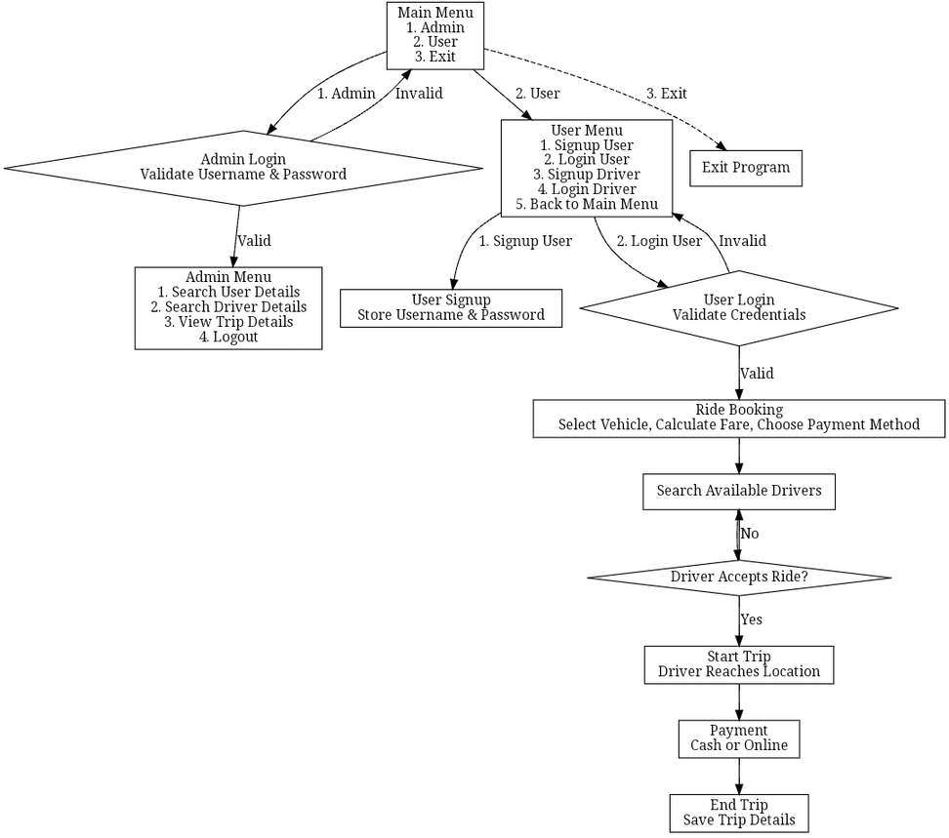
Implementation/Workflow
15

Slide 16
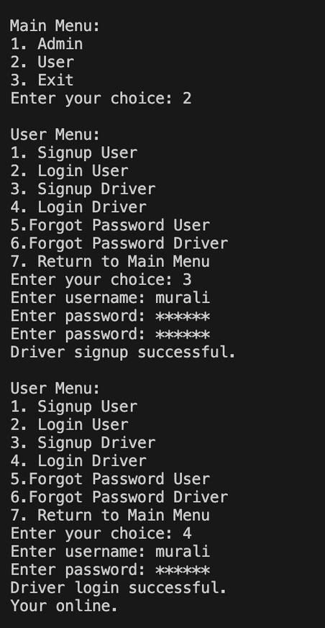
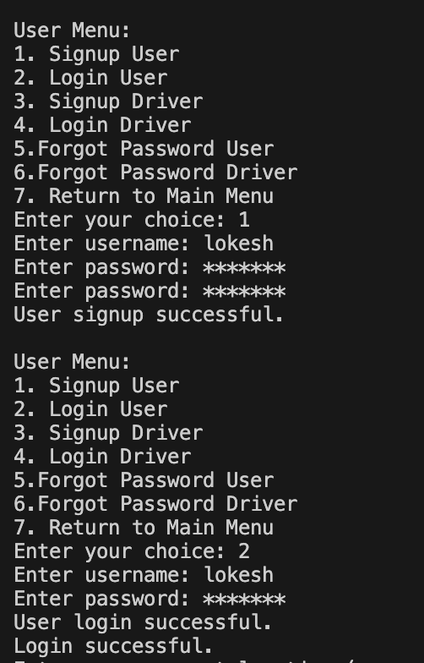
RESULT
Driver login:
User login:
16

Slide 17
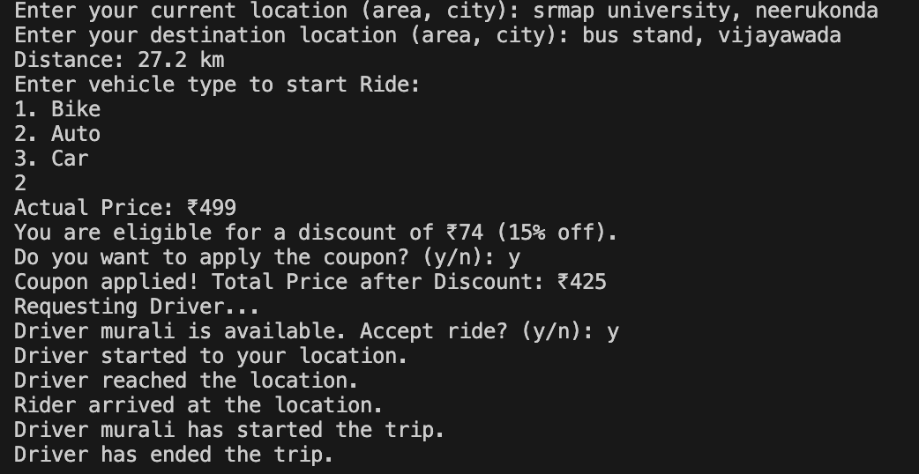
RESULT
Ride Booking:
17

Slide 18
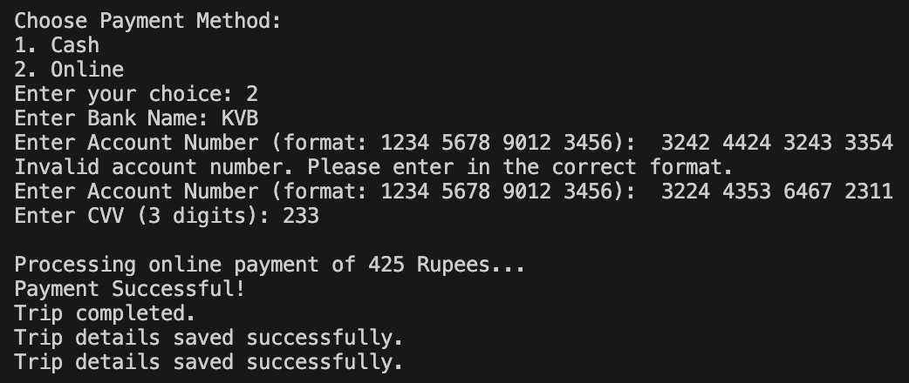
RESULT
Payment Method:
18

Slide 19
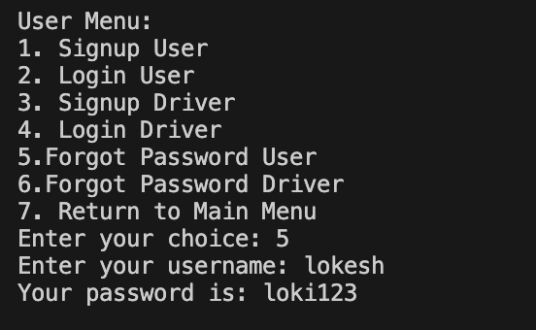
RESULT
Forgot Password:
19

Slide 20
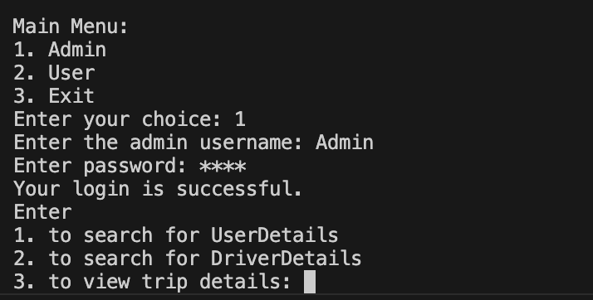
RESULT
Admin Login:
20

Slide 21
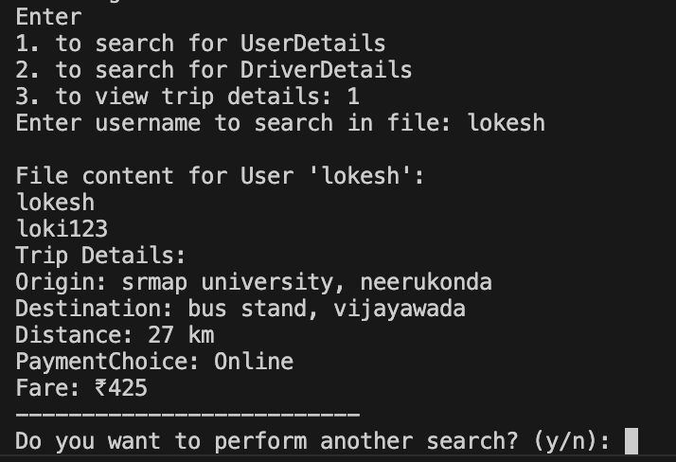
RESULT
Admin Access:
21

Slide 22
CONCLUSION
Ride-sharing apps are transforming urban transportation by providing reliable, affordable, and sustainable solutions. These platforms are designed to make commuting easier and more accessible for everyone, addressing the evolving needs of modern cities.
Key features of ride-sharing apps include secure user management, ensuring safe and seamless interactions between drivers and riders. Optimized routing reduces travel time and costs, while intelligent ride matching ensures efficient utilization of vehicles, contributing to a smoother travel experience.
22

Slide 23
Future Work
• Feedback System:
• Riders and drivers can rate each other after a trip.
• Feedback will help improve service quality and provide user insights.
• OTP Verification for Ride Start:
• Riders will receive a One-Time Password (OTP) when booking a ride.
• The driver must enter the OTP to begin the trip, ensuring ride security and preventing unauthorized trips.
23

Slide 24
References
Libraries and APIs:
JSON for Modern C++: nlohmann. A JSON library for C++. Retrieved from https://github.com/nlohmann/json
cURL Library: Client-side URL transfer library. Retrieved from https://curl.se/
GoMaps API Documentation: Geocoding and Distance Matrix API. Retrieved from https://maps.gomaps.pro/
24

Slide 25
References
Online Tutorials and Documentation:
GeeksforGeeks. C++ File Handling. Retrieved from https://www.geeksforgeeks.org/
TutorialsPoint. C++ Input/Output Streams. Retrieved from https://www.tutorialspoint.com/cplusplus/
C++ Language Documentation:
ISO C++ Standards Committee. (2023). C++ Standard Library Reference. Retrieved from https://isocpp.org/
25

Slide 26
THANK YOU
26

